Slide 1
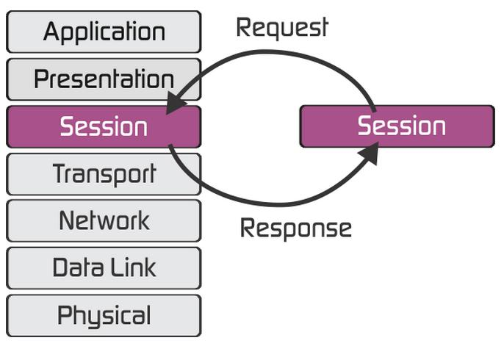
Secure Sockets Layer (SSL)

Slide 2
Basics
Encrypted Connection b/w -
Website – Browser
Mail Server – Mail Client
Normal Connection – plain text transfers
SSL Connection – Encrypted (Asymmetric + Symmetric keys)
(lock icon and starts with https)
Versions : Latest till SSLv3.0 , then TLS(Transport Layer)v1.2

Slide 3
Keywords
Certificate Authority (CA)
A trusted organization that issues SSL certificates.
Present in browser’s pre-installed CA trust store.

Slide 4
Keywords
Certificate Signing Request (CSR)
A request by a website owner to get SSL certificates from a CA.
Gives Public and Private key to owner.
Details in CSR –
Common name
Org name
Location
Key type (eg. RSA)
5) Key-Size (2048bit minimum)

Slide 5
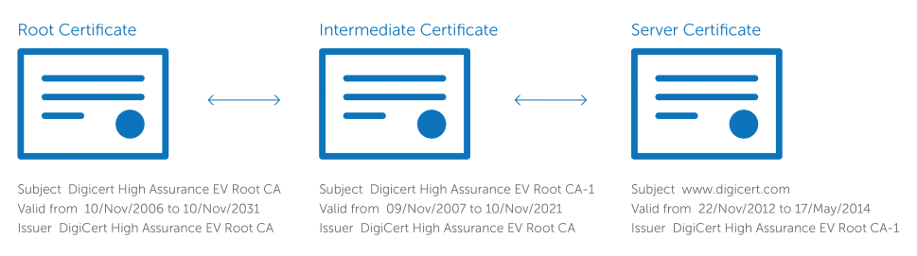
Installing an SSL certificate
Request by CSR – receive SSL cert and Intermediate Cert
Install both on server
Intermediate Cert – Needed to protect root cert, link b/w SSL cert anf root cert

Slide 6
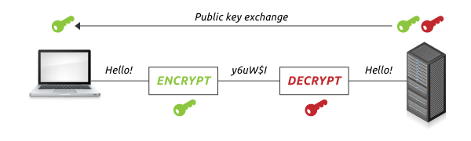
Asymmetric Encryption (Public-key Cryptography)
Public key to encrypt – Private key to decrypt
Size : 1024 to 2048 bits ~ max 2^2048 combinations
Examples: RSA and Elliptic Curve Cryptography (ECC)

Slide 7
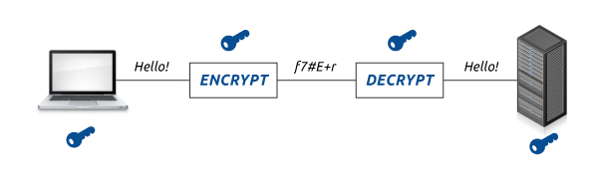
Symmetric Encryption (pre-shared key encryption)
Sender and Receiver need same key
Size: 128 to 256 bits

Slide 8
Comparison
Parameters: computational burden and ease of distribution
Disadvantage of Symmetric:
if you have to send the key to a user halfway around the world (a more likely scenario) you need to worry about data security.
Advantage of Asymmetric:
2048bit key (average computer will take more than 14 billion years to crack)
Power of private key – secret to end user!

Slide 9
SSL Handshake
Browser – Connects to https website and asks for server identity
Server- Sends SSL cert with public key to Browser
Browser- Checks for validity of SSL cert (expired/authentic) against its preinstalled list of CAs, if valid – creates, encrypts a session key with server’s public key and sends it to server
Server- Decrypts session key using its private key, sends back ACK encrypted with session key
Browser and Server use session key (symmetric) to transfer encrypted data in this session.

Slide 10
View Trust Store
Chrome -> Settings -> Certificates -> Trusted Root Certs

Slide 11
XCA Demo

